Slide 1
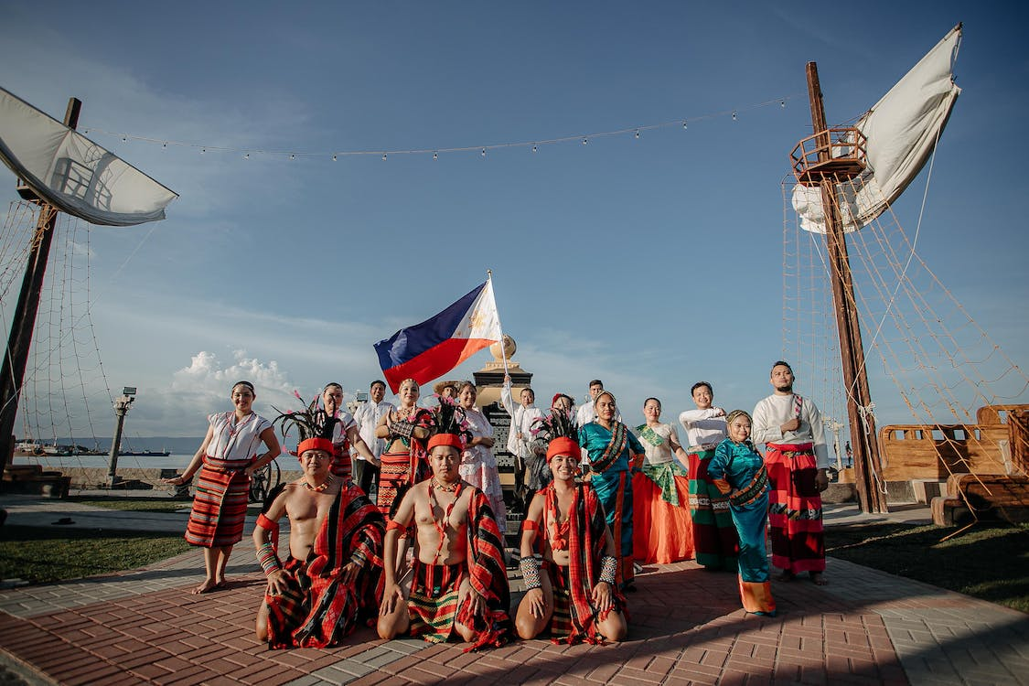
Lakwatsa Mini Project 1 – Kenneth Abenoja

Slide 2
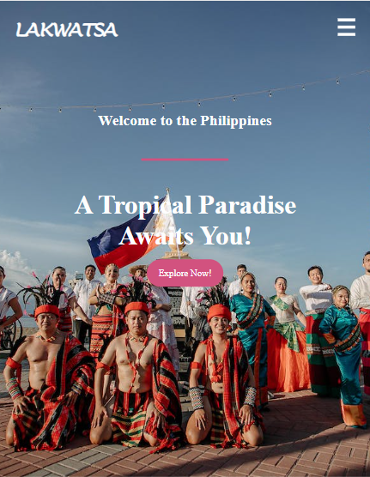
lakwatsa
Purpose
Share experiences, destinations, activities, and people you've encountered, inspiring others to explore the world.
Express your unique perspective on travel, culture, and the world as a creative outlet.
Build a community of like-minded individuals who share a passion for exploration and connect with them.
Provide valuable information, advice, and inspiration for trip planning through itineraries, guides, tips, and recommendations.
Establish networking opportunities and collaborations with travel brands, tourism boards, and fellow bloggers/influencers.
Preserve travel memories in a structured format, reliving and sharing experiences through writing and photographs.

Slide 3
Start
Lakwatsa
Home
Tours
Explore
About
Contact
It will redirect you to the home page
It will redirect you to the tours page
It will redirect you to the explore page
It will redirect you to the about page
It will redirect you to the contact page
End

Slide 4
HEADER IMAGE BACKGROUND
Lakwatsa
Home
Tours
Explore
About
Contact
TEXT HERE
Upcoming Events
image1
image2
Text Here
Text Here
BACK GROUND IMAGE HERE
Text Here
TEXT HERE -> Promotional
image1
image2
Image 3
Image 4
About
Lakwatsa All You Need to Know!
Contact
Form.
Lakwatsa Short feature
Social Media Link, Address Etc…

Slide 5
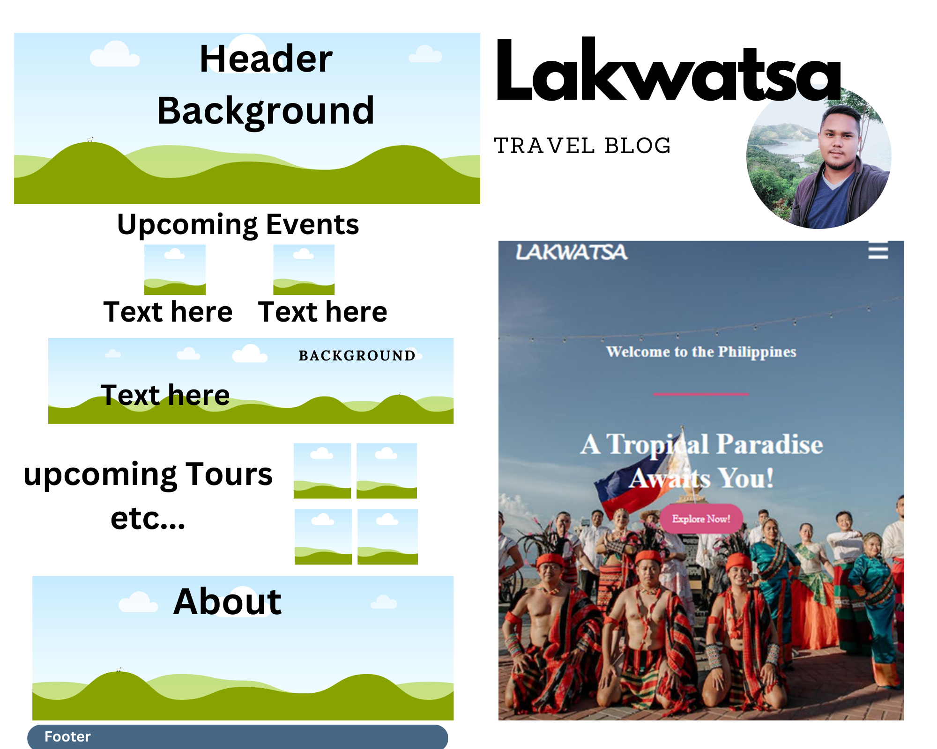

Slide 6
